Slide 1
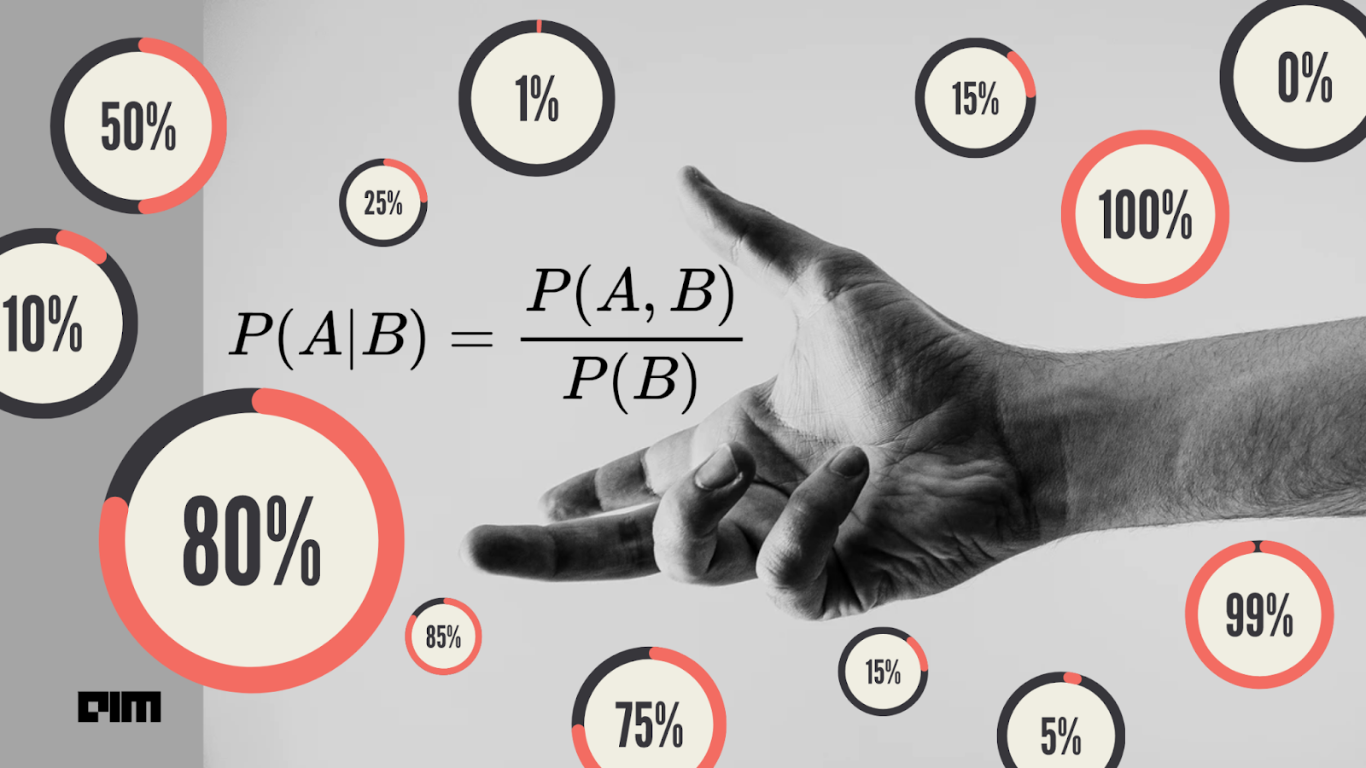
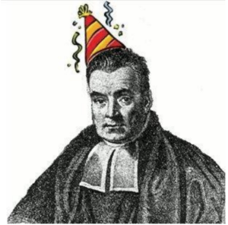
Naive Bayes Classifier Project
By Hagai Kraus
Gel Peled
Lior Aronov
Yoav Alperin
Credits Daniel Yonin , Merav cohen.
For more information on Naive Bayes
Thomas Bayes

Slide 2
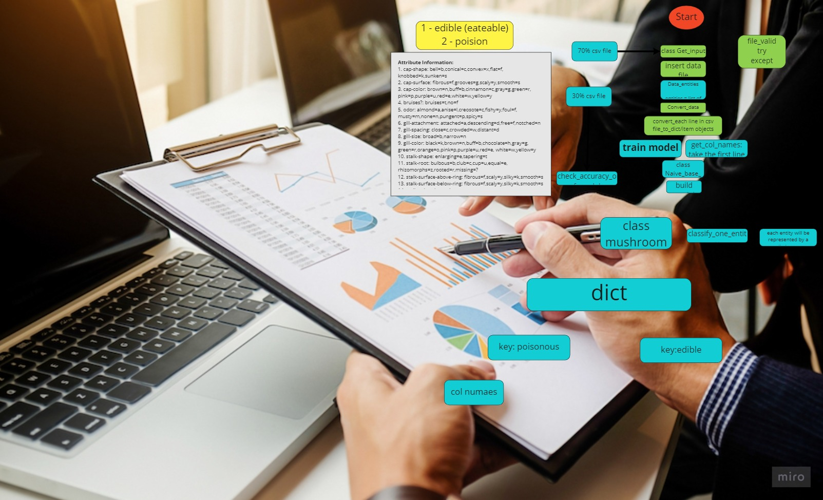
Our Project
A prediction tool according to a naive Bayesian model (a statistical approach to decision-making under conditions of uncertainty)
Our Software receives data (csv files) , studying the data and , performs statistics according to a naive Bayesian model and presents the classification results.
The accuracy that required from us is 90% accuracy Our software returns 96.92% accuracy As of this time

Slide 3

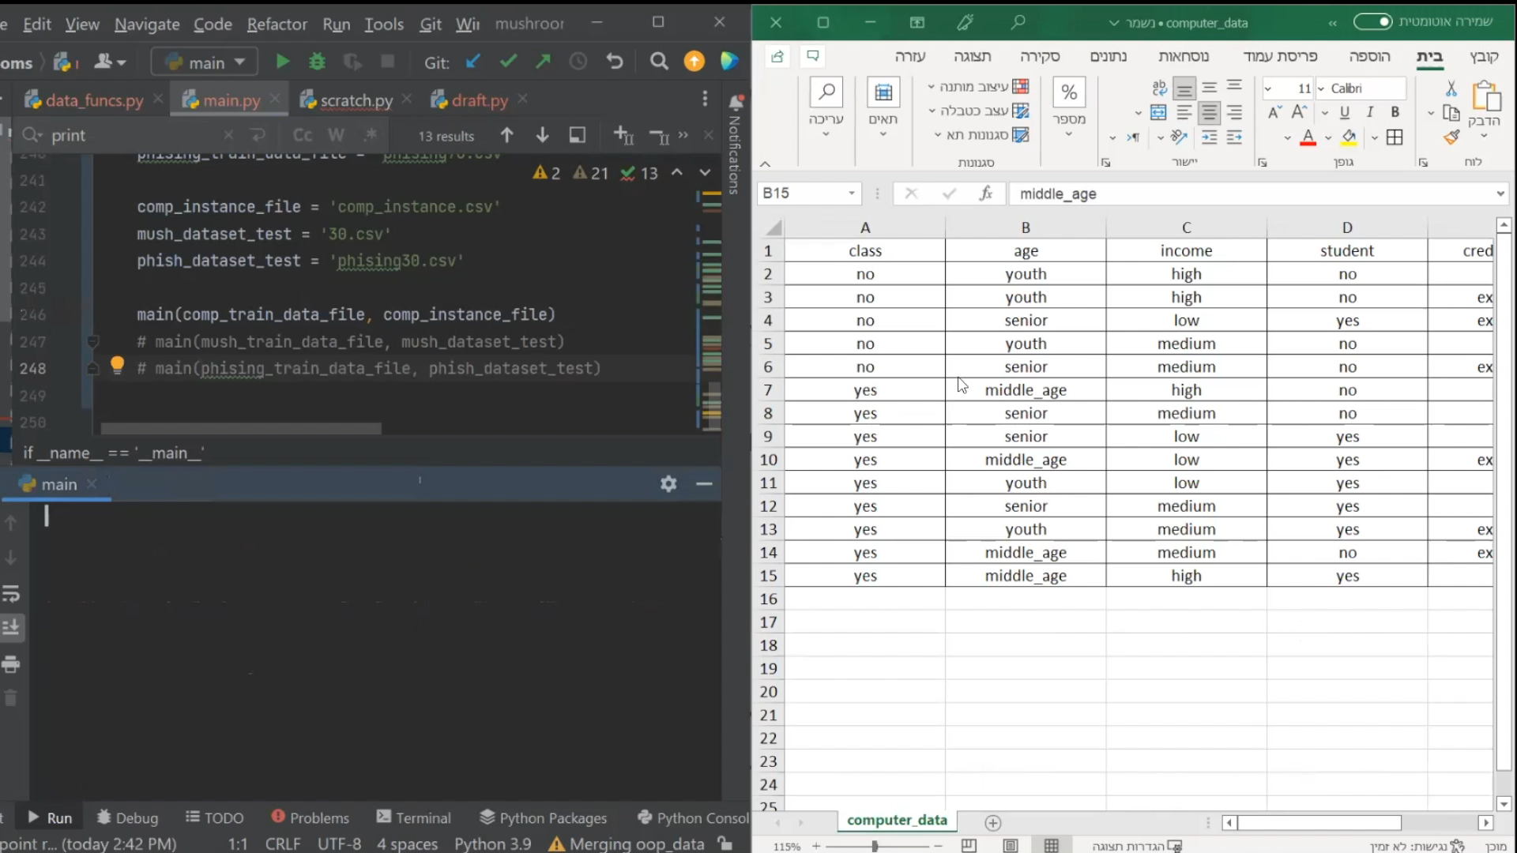
Demonstration

Slide 4
Link To The Code In Github:
https://github.com/krauson/data-analysis

Slide 5

Technical Specifications
The program is able to process all kind data and infinite number of classifiers for that data.
There are two features:
-Analyzing one instance and giving the chances for each possible classifier for that instance.
-Analyze set of dataset and test the model for number of correct classifications.
The data and the model are represented using dictionary encapsulation (dictionary inside a dictionary):
data: {'yes': {'age': ['youth', 'youth', 'senior', 'middle_age', 'senior’]}}
model: {'yes': {'age': {'senior': 0.4, 'youth': 0.4, 'middle_age': 0.2}​}}

Slide 6

Work flow
Flowchart
Distribution of tasks to the team
Building the code
Testing and fixing bugs in the code
Testing and researching the results
Consulting with a Yaniv for the purpose of improving the software
Reaching to the existing model

Slide 7

Challenges And Success in teamwork
Knowledge gaps
Assignment of tasks according to abilities
Availability and continuous communication between team members in Slack
lack of time:
Assignment to small tasks during the educational framework in the boot camp
Total responsibility and commitment of all team members involved
Inaccuracy problem (last week we got 50% accuracy)
The entire computational part had to be reprogrammed

Slide 8

In Two Weeks From Now
More user friendly
Graphical user interface
Make the software more object oriented

Slide 9

Questions ?

Slide 10



Slide 11
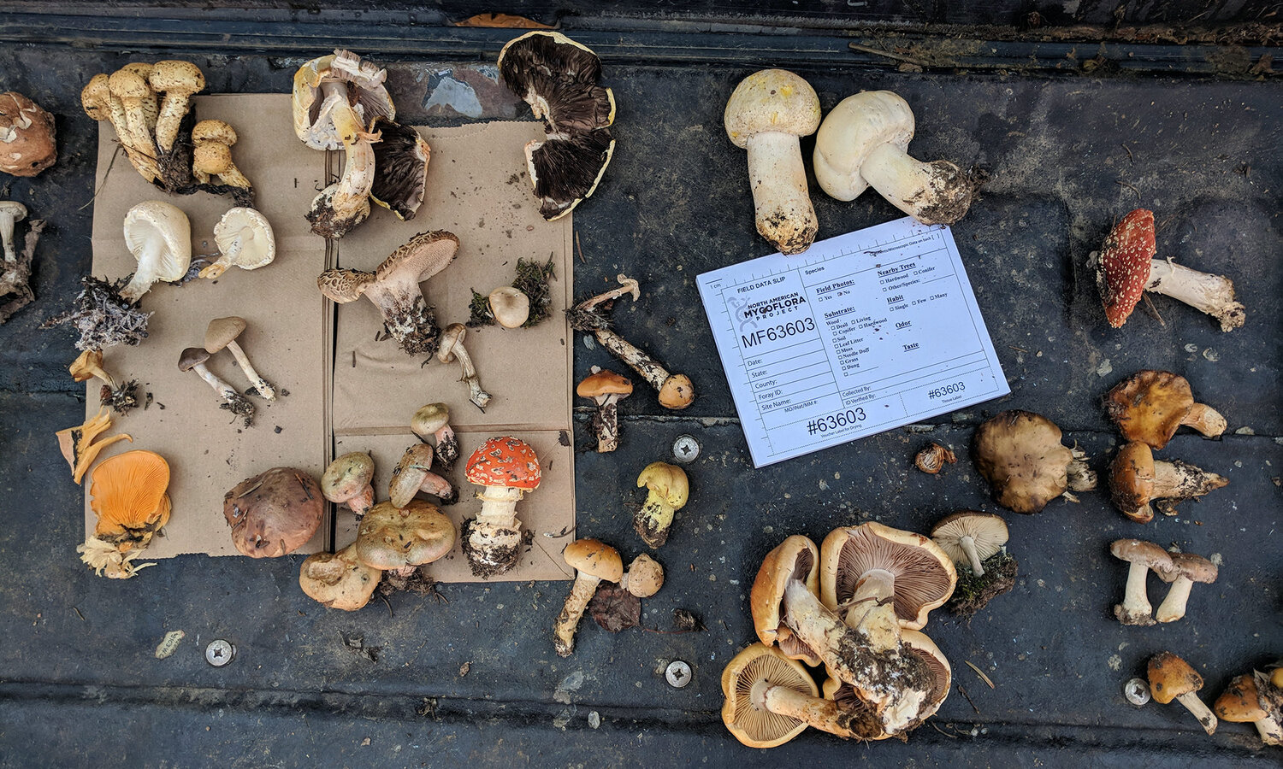
Thanks!

